Slide 1




Assessment of relationship between two binary variables and the effect over the sample size calculation for a Composite Endpoint
Endpoints Overlap and Sample Size Requirements
Josep Ramon Marsal; Ignacio Ferreira-González i Lupe Gómez

Slide 2
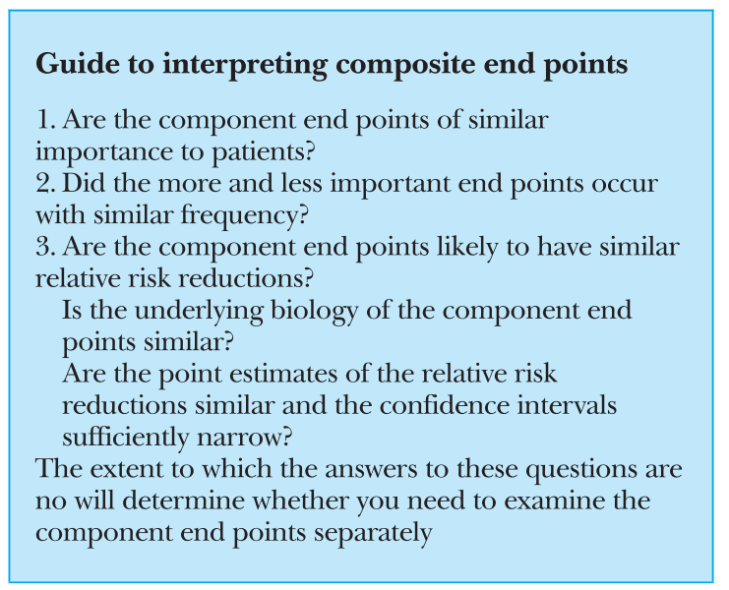
Some points to take into account
A Composte Endpoint (CE) is defined as the combination of two or more outcomes in an unique outcome.
  Survival (time to MACE: death, reinfarction, revascularization, stroke → competing risk).
  Binary (MACE)
  Score (Framingham)
We asume a CE well defined (with clinical/patient relevance and importance).
We defiene a binary CE as the combination of a Primary Endpoint (PE) and Additional Endpoint (AE) (≥ 3 endpoints in progress).
Montori V. et al. BMJ. 2005:303;594-596

Slide 3




The situation
Typical Situation: A clinician wants investigate about the effect of a new drug and he/she puts in touch with us to calculate the sample size requirement.
Typical Response: I need the prevalence of the outcome and the effect of the new drug on the outcome
Well, really the outcome is a Composite Endpoint.
There are several endpoints with different prevalence and different effect for each component and of course exist some grade of associations between them.

Slide 4
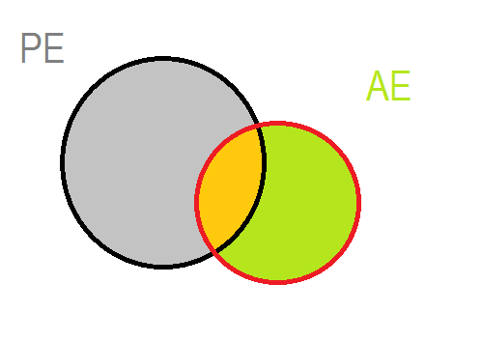
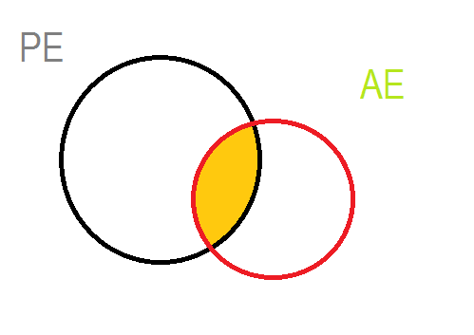
Some points to take into account
We defiene a binary CE as the combination of a Primary Endpoint (PE) and Additional Endpoint (AE) (≥ 3 endpoints in progress). For simplicity: 2 outcomes.
  CE effect may either increase or decrease the effect of each component.
For simplicity we consider a Randomized Clinical Trial with only two treatment groups (e.g. 0: control & 1: active treatment).
Our Main outcome: Sample Size Requirement (SSR).

Slide 5
Objectives
How to quantify the strength of relationship between components of a binary CE.
To explore the impact of the strength of the interrelation between components on the sample size requirement using the CE, which ultimately can be useful to choose between a binary CE and one of its components

Slide 6

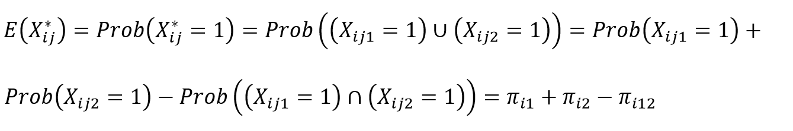
Some definitions
A vector of binary variables (RE and AE) for the jth subject in the ith treatment group (i=1,2)
Remember: The CE (X*) takes value 1 if occurs either RE or AE or both together, so when Xij1=1 and/or Xij2=1.
(1)
But how we can estimate the joint probability?

Slide 7

The Fréchet Bounds
Fréchet (1960) noted that the strength of the association have a lower and upper bound, then not all the values are possible.
If we use the joint probability as the estimation of the strength of association the next formula define this bounds.
But other indicators might be useful to estimate the strength of association (e.g. correlation).
Bahadur (1961) and Oman Samuel (2001) worked in this way.

Slide 8

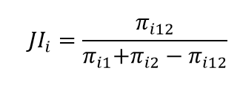

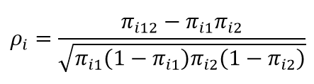
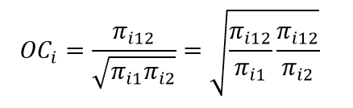

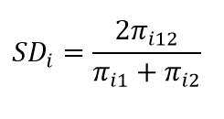
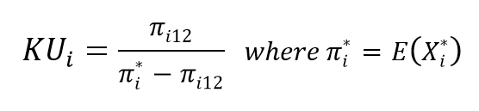
Association Measures
Index | Author | Index
Joint Probability | Russel & Rao (1940)
Overlap | Jaccard (1901)
Relative Overlap | Szymkiewicz-Simpson (1943)
Rho Coefficient (correlation) | Yule (1912)
Ochiai | Ohiai (1957)
Simple Pair | Sokal & Michener (1958)
Sørensen-Dice | Sørensen-Dice (1913-1948)
Kulcynsky | Kulcynsky (1927)
For P(RE) = 0.01 to 0.40
For P(AE) = 0.01 to 0.40

Slide 9
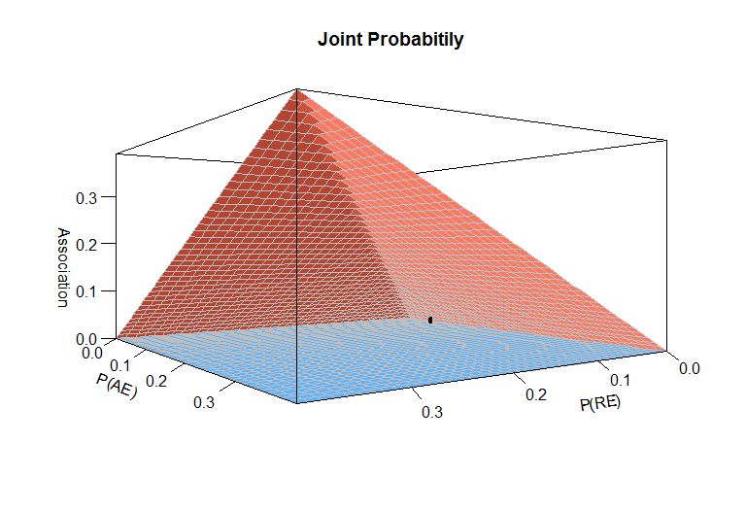
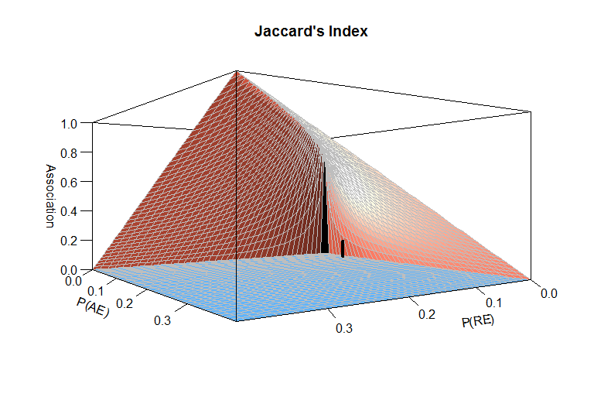
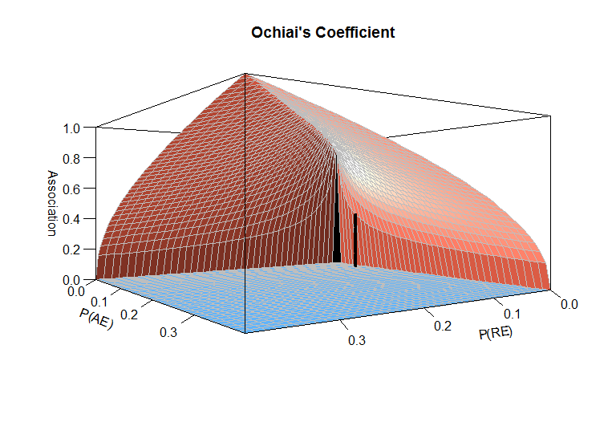
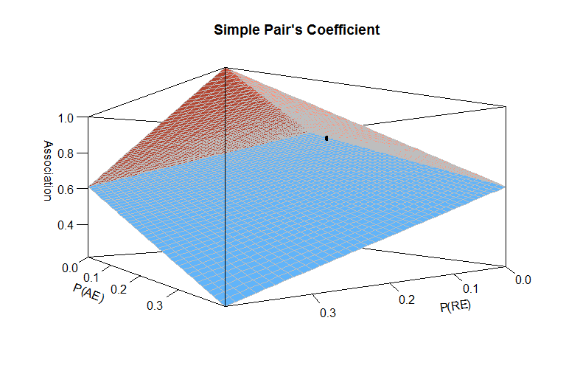
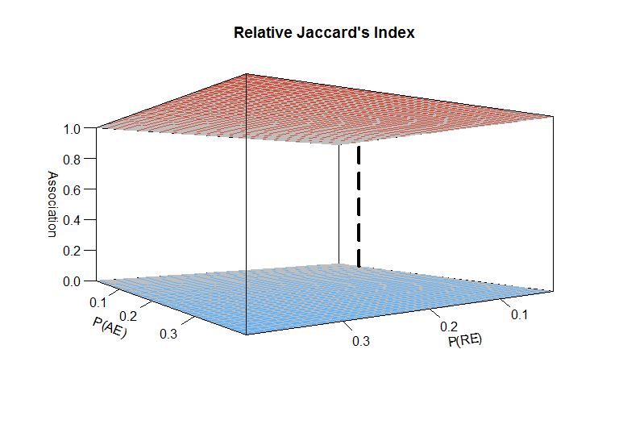
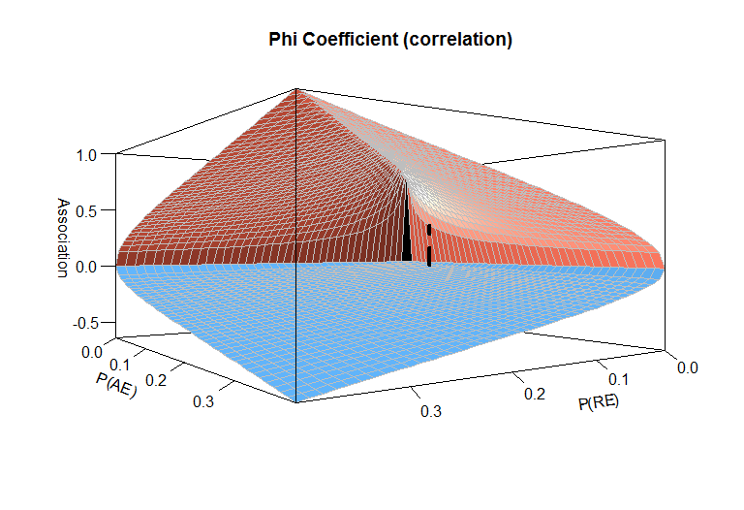
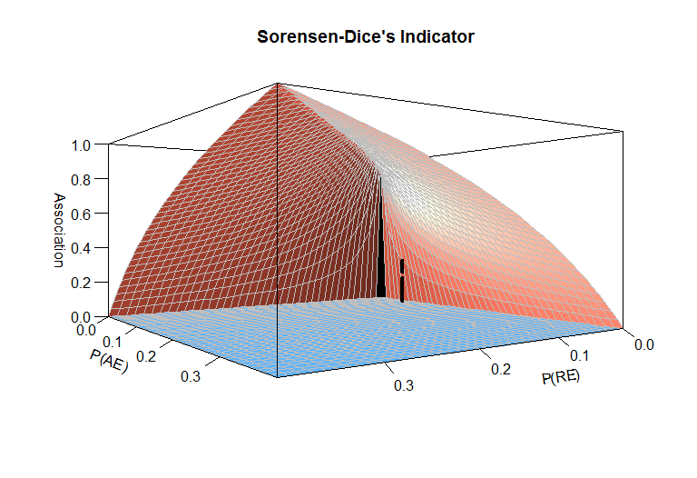
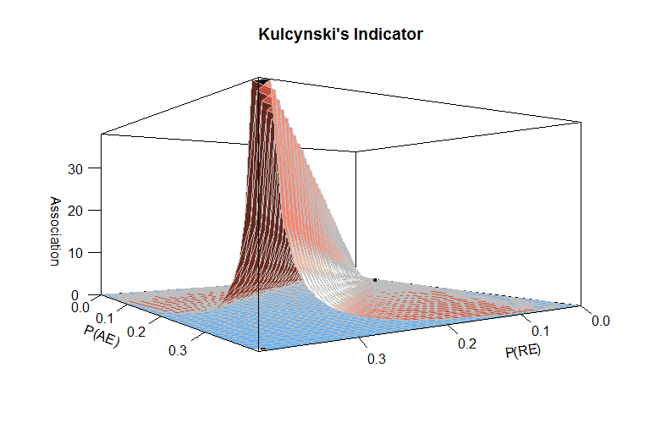

Slide 10
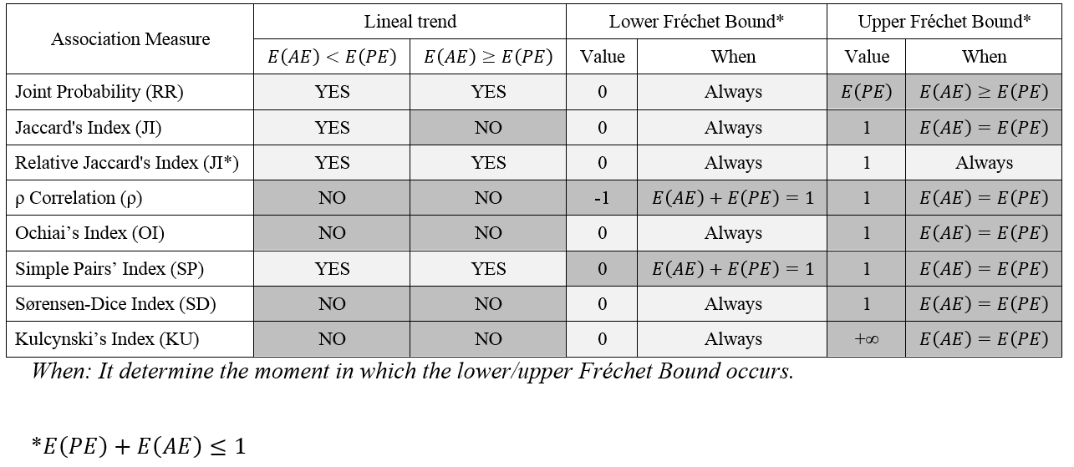

Slide 12
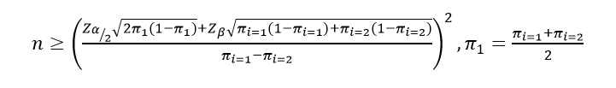

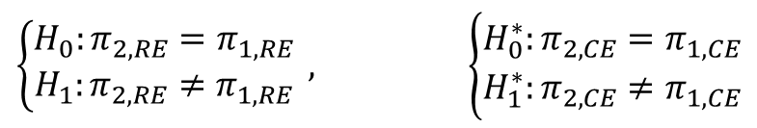
Sample Size and Statistical Power
We need to assess the effect size of the treatment. Risk Ratio (but we can use others: OR, difference of proportions)
The Sample Size Requirement must be assessed for the PE and for the CE. The contrasts of hypothesis are different. It is assumed the approximation to de Normal distribution.
It defines de Sample Ratio (SR = n/n*)
  CE will be preferred if SR > 1
It assumes the Overlap is the same in both groups.
Multiplicity adjustment ignored
It fixes α=0.05 and β=0.20
$$\left\{\begin{matrix}H_{0}:π_{2,RE}=π_{1,RE} \\ H_{1}:π_{2,RE}≠π_{1,RE}\end{matrix}\right. , \left\{\begin{aligned}&H_{0}^{∗}:π_{2,CE}=π_{1,CE} \\ &H_{1}^{∗}:π_{2,CE}≠π_{1,CE}\end{aligned}\right.$$

Slide 13
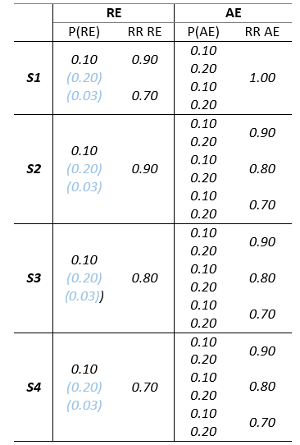
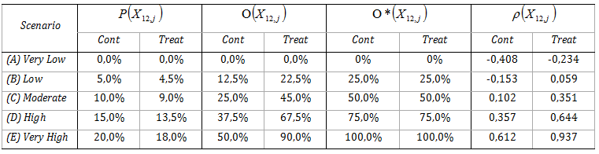
Numerical Examples
We simulated several scenarios assuming:
Different values of the proportion for both the RE and the AE
The effect of therapy on each endpoint (RR)
Different strength and the degree of overlapping (5 cut-offs)
Same Overlap in both groups***

Slide 14
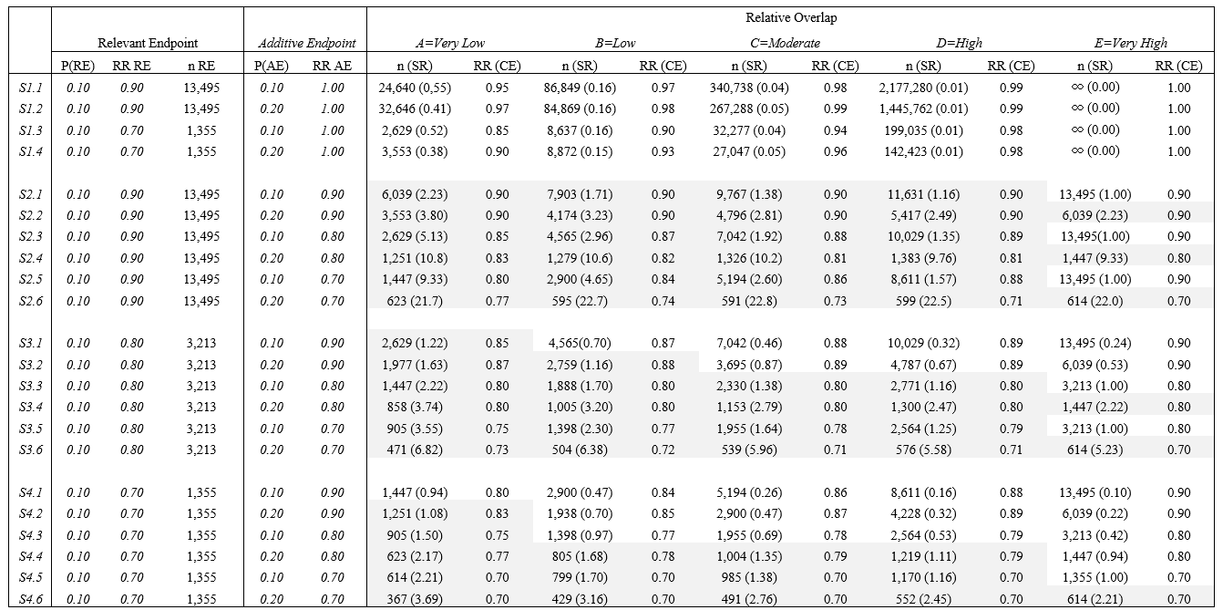
Results I

Slide 15
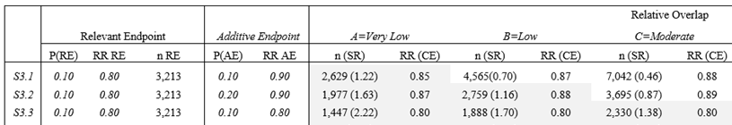

Slide 16
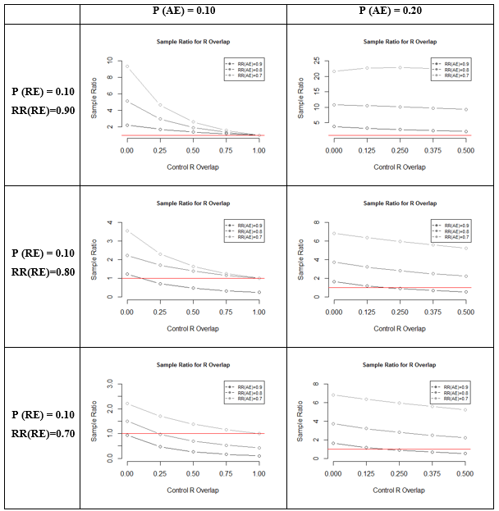
Results II

Slide 17
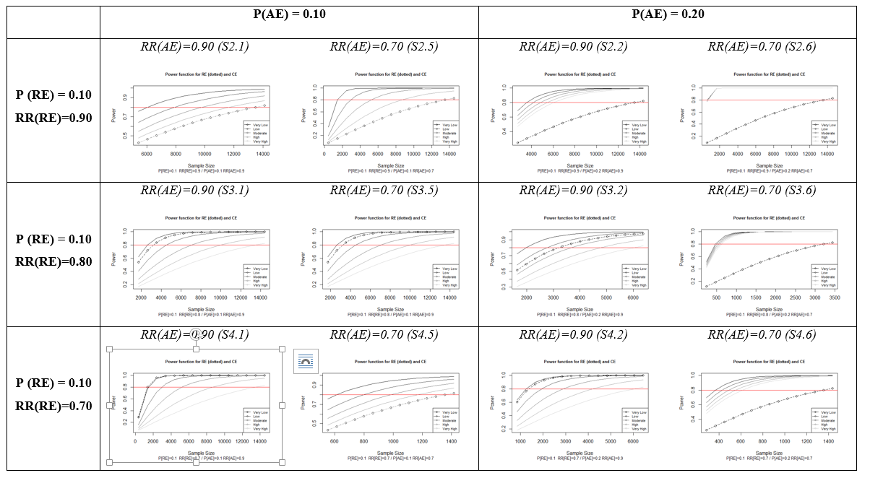
Results III

Slide 18
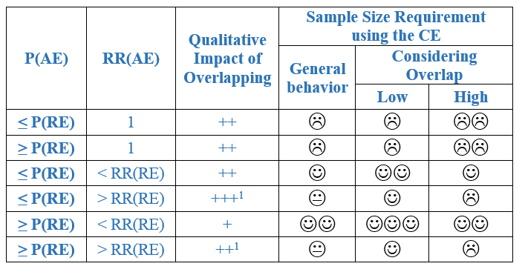
Conclusions II

Slide 19
Conclusions I
The strength of interrelation between components of a binary CE can be quantified by the probability of experiencing two outcomes given that the patient has experienced the less prevalent or others (i.e. the Relative Jaccard Index).
The association can be determinant of the sample size requirement using the CE.
The greater degree of association, the lower the potential benefit of the CE to reduce sample size requirement.
The impact of the association on the sample size requirement using the CE depends on the effect on the additional endpoint.
The strength of interrelation between CE components must be considered in the design phase of a randomized clinical trial.

Slide 20
Further Researches
The impact of interrelationship when the CE is defined with three or more events. (in progress)
How affect the multiplicity adjustment on the sample size requirement?
The distributions of other measures to estimate the relationship between binary outcomes (in progress)
Does the actual bibliography respect the sample size requirement in function of the strength of the association of their components?

Slide 21
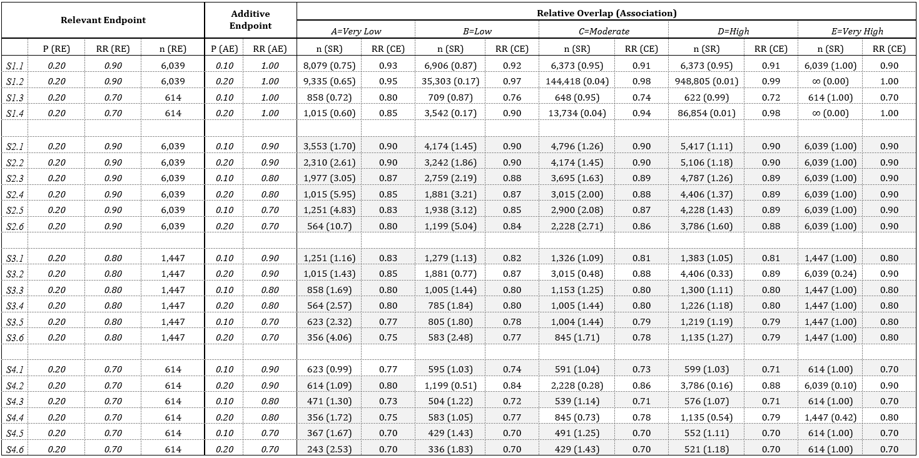

Slide 22
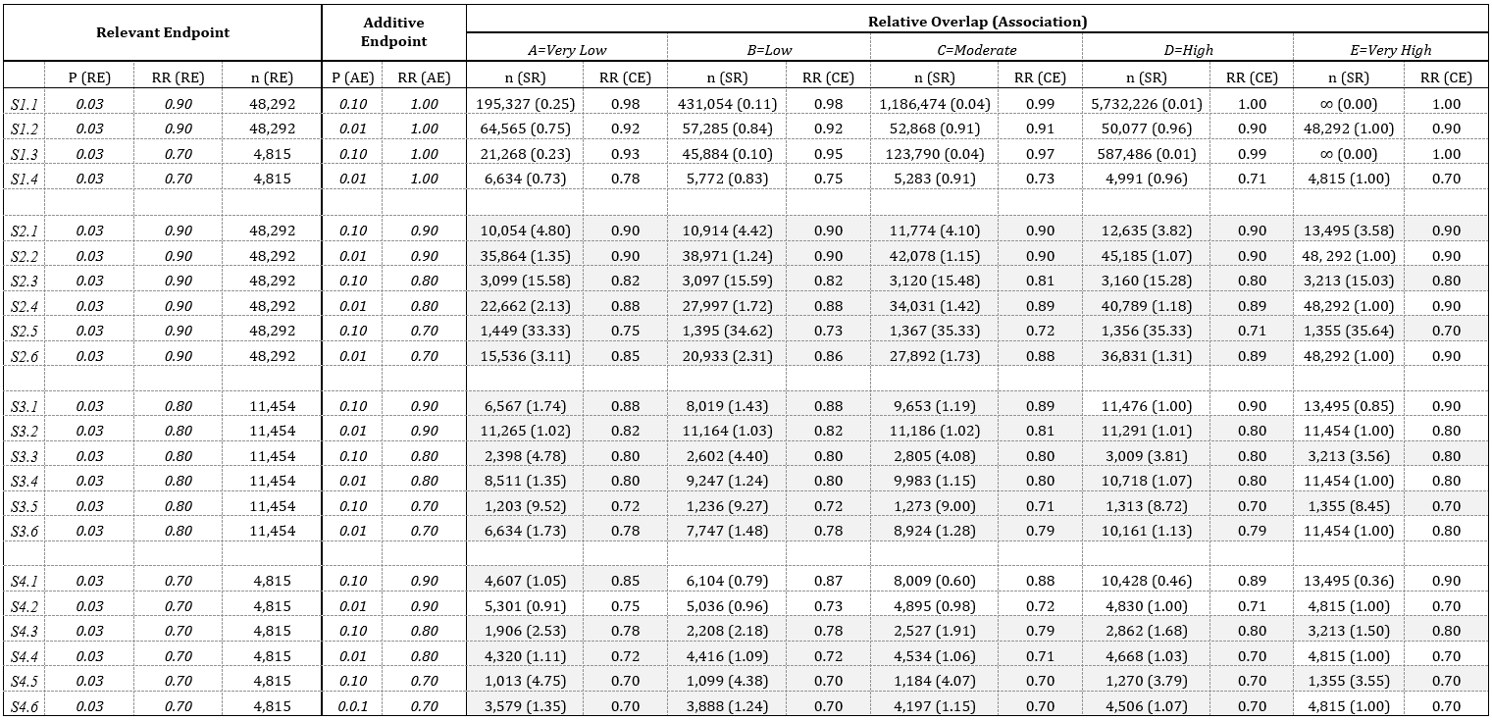

Slide 23
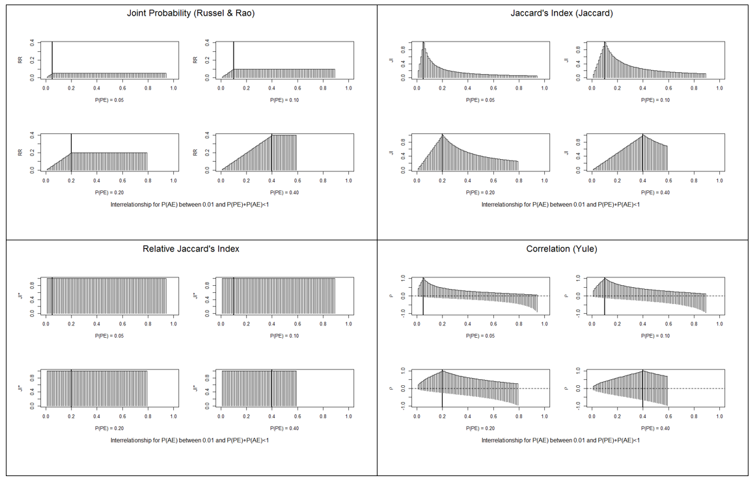

Slide 24
